Slide 1
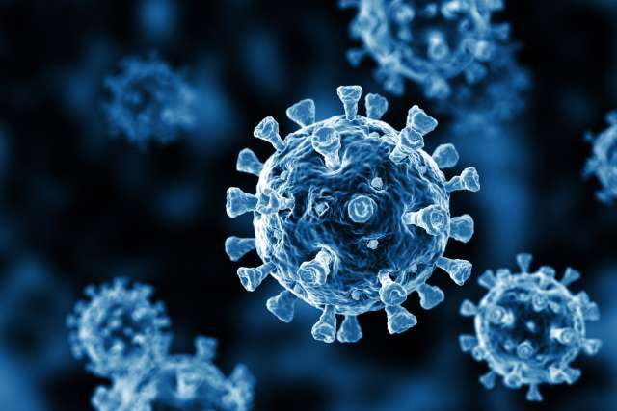
Disease Prediction with Symptoms
CSE 575 SML PROJECT
Group 5:
Gowthami Radha Ananthaneni - 1224235025
Pratik Giri - 1224255318
Nikitha Vipala - 1222193674
Sarika Naidu Chiriki - 1224450630
Sreya Sukhavasi - 1224567162

Slide 2
Table of contents
Introduction
Problem Description
Dataset Description
Methodology
Results
Conclusion and Future work

Slide 3
Introduction
In this fast-paced world, taking care of oneself is more complicated than we imagine. Most people do not realize how much health is important before it is too late.
In their busy lives, taking time to get their body checked once in a while is vital, but most people do not incorporate these steps in their plans due to workload or external factors.
Also, a medical specialist cannot always be available, and a doctor can often diagnose based on the medical examination findings done with these models.
Therefore, a disease prediction system is often built to help patients at different stages in predicting disease as well assist the medical professionals
Different insights can be constructed based on the results of these disease prediction models

Slide 4
Introduction
Previous work and Results:
Ramalingam, V. V., Ayantan Dandapath, and M. Karthik Raja. "Heart disease prediction using machine learning techniques: a survey." International Journal of Engineering & Technology 7.2.8 (2018): 684-687
Naive Bayes, SVM, KNN, Decision Tree and Random Forest models were used
Our Contribution:
Implemented similar models with changes to better accommodate our dataset
Additionally we used models like MLP and Deep Learning to further improve the accuracies

Slide 5
Problem Description
With the evolution of Big Data technology in this era, predicting diseases has been given more attention as health comes before anything.
Hence the main focus is on diagnosing and identifying diseases using Machine Learning and deep learning techniques.
The main goal of this project is to use efficient algorithms to help patients by predicting the disease before it is too late.
The results of the different techniques implemented are compared in terms of accuracy and performance to provide a better solution.

Slide 6
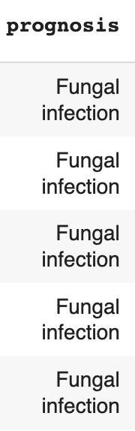
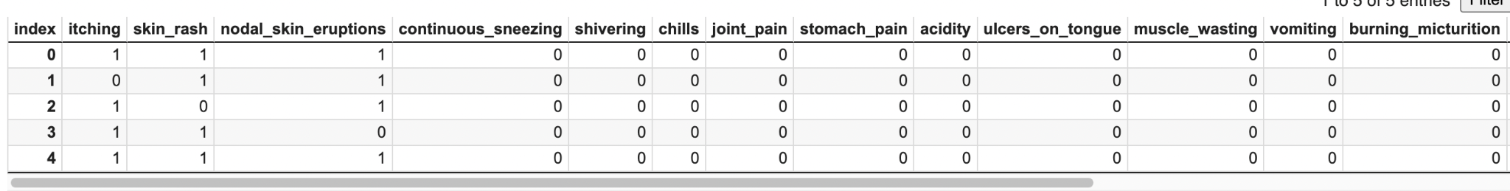
Dataset Description
“Disease Prediction Using Machine Learning” from Kaggle
Total 133 columns
Enables the prediction of different diseases such as Diabetes, Hypertension, Heart Attack, etc.

Slide 7
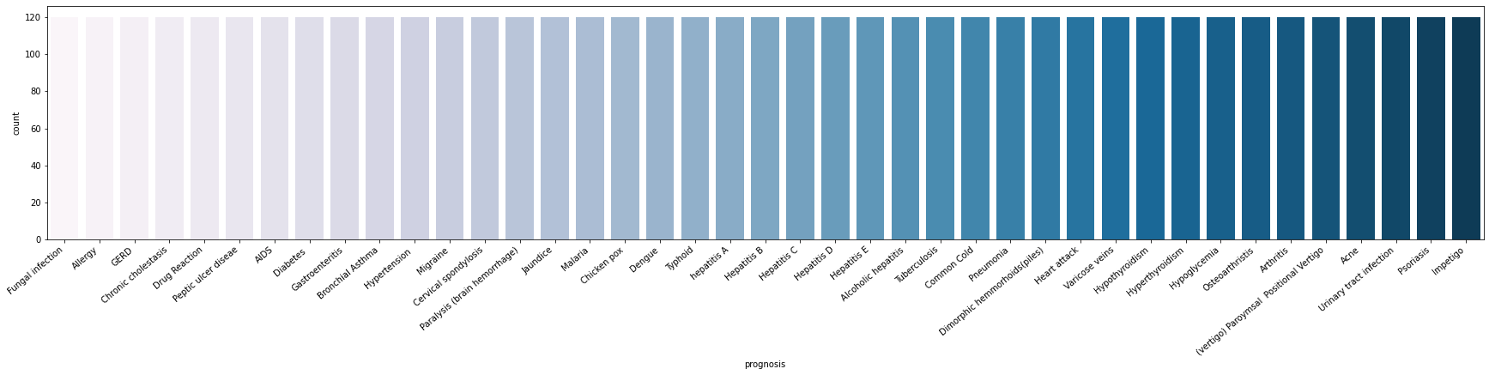
Dataset Description
Very balanced dataset
Each of the 41 possible diseases have equal 120
numbers of data points

Slide 8
Methodology
Following Models are implemented to compare and achieve the best results:
Linear Regression
KNN
Decision Trees
Neural Network
Multilayer Perceptron (MLP)
Deep Learning

Slide 9
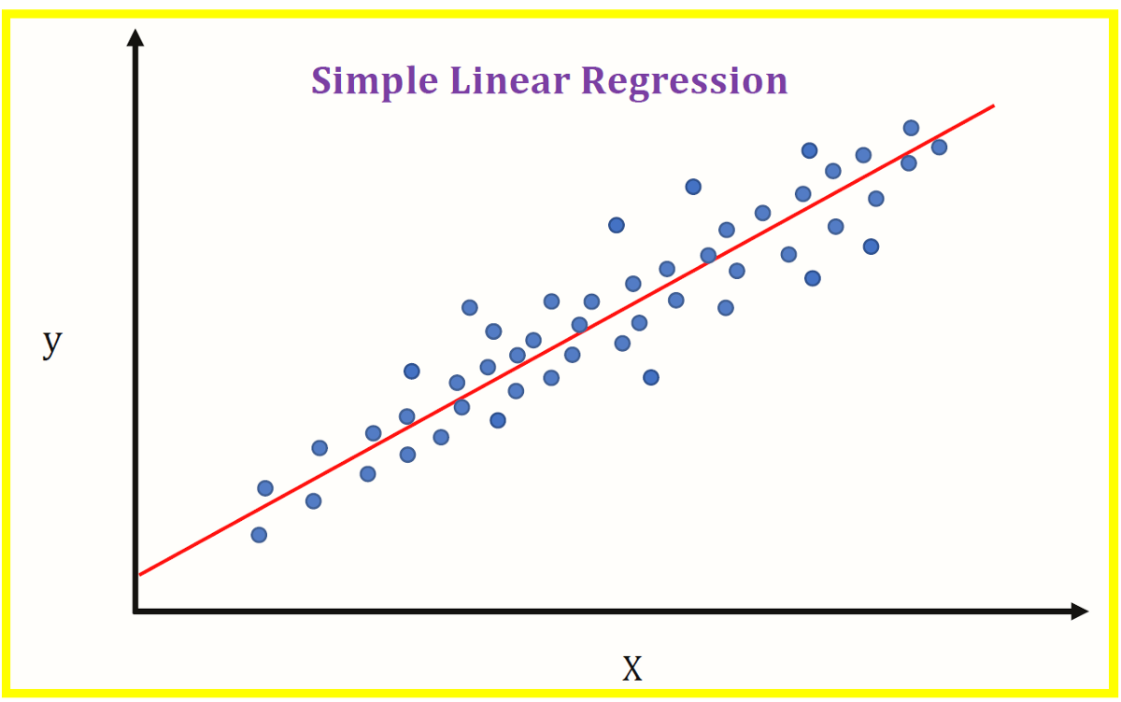
Linear Regression
Linear Regression is a supervised machine learning technique. It is used to predict a dependent variable(Y) based on an independent variable(X)
Here, the symptoms are the independent variable and the probability of having the disease is the dependent variable
This regression method is used to find out the linear relationship between ‘X’ and ‘Y’

Slide 10
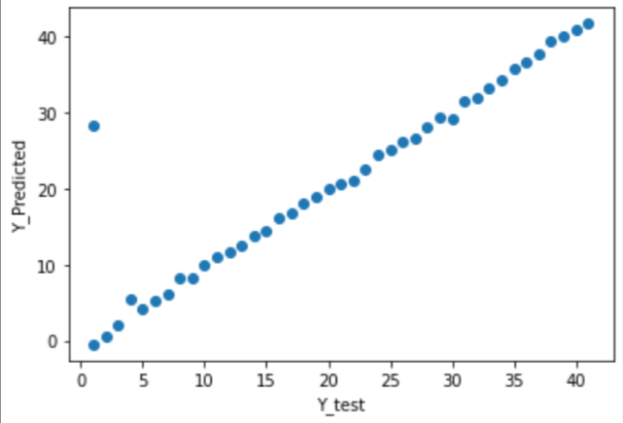
Results
r2_train: 97.41% r2_test: 87.41%
MAE_train: 1.17 MAE_test: 1.19
MSE_train: 3.62 MSE_test: 18.38
RMSE_train: 1.90 RMSE_test: 4.29
MAE - Mean Absolute Error; MSE - Mean Squared Error; RMSE - Root Mean Square Error

Slide 11
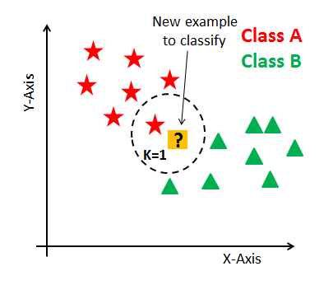
K-Nearest Neighbor
K-Nearest Neighbor algorithm is supervised learning as it relies on the labeled data for learning the functions
Developed a model which uses a non-parametric method and finds the similarities between the values and predictors within the dataset
The model runs on the training set and predicts the testing data which results in the True or False output

Slide 12
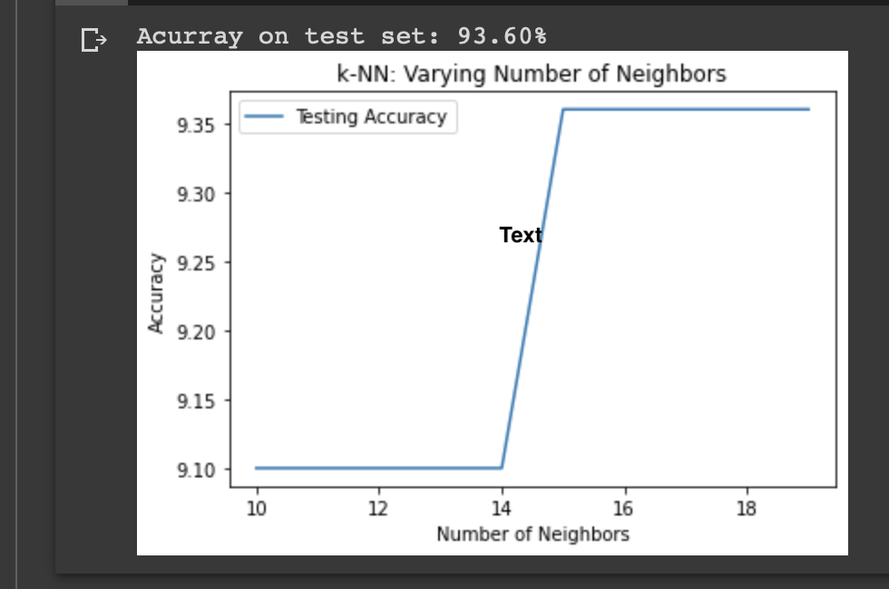
Results
The accuracy increased with increase
in the number of neighbors
We have used 10-20 number of neighbors
as there was increase in the accuracy at 15
neighbors
Further increase in K led to
no improvement in the accuracy.
Accuracy - 93.6%

Slide 13

Decision Tree
A decision tree model predicts the output value by learning simple decision rules inferred from the data features
Developed a model that uses Gini Impurity as a way to split the dataset into a series of decisions.
The Gini Impurity measures the likelihood that an item will be misclassified if it’s randomly assigned a class based on the data’s distribution.

Slide 14
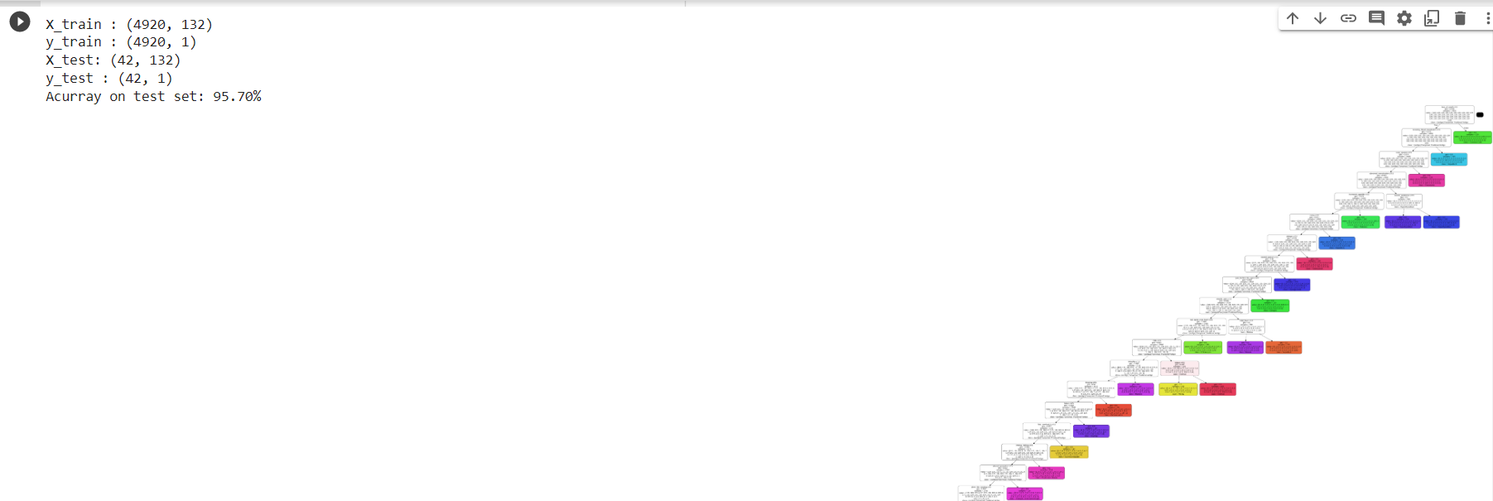
Results
The Decision tree works with the underlying symptoms and predicts a disease
The symptoms are passed as input to the model for predicting the disease.
This array matches the disease data collection and ends at a common leaf node with the highest degree of trust
Accuracy: 95.7%

Slide 15
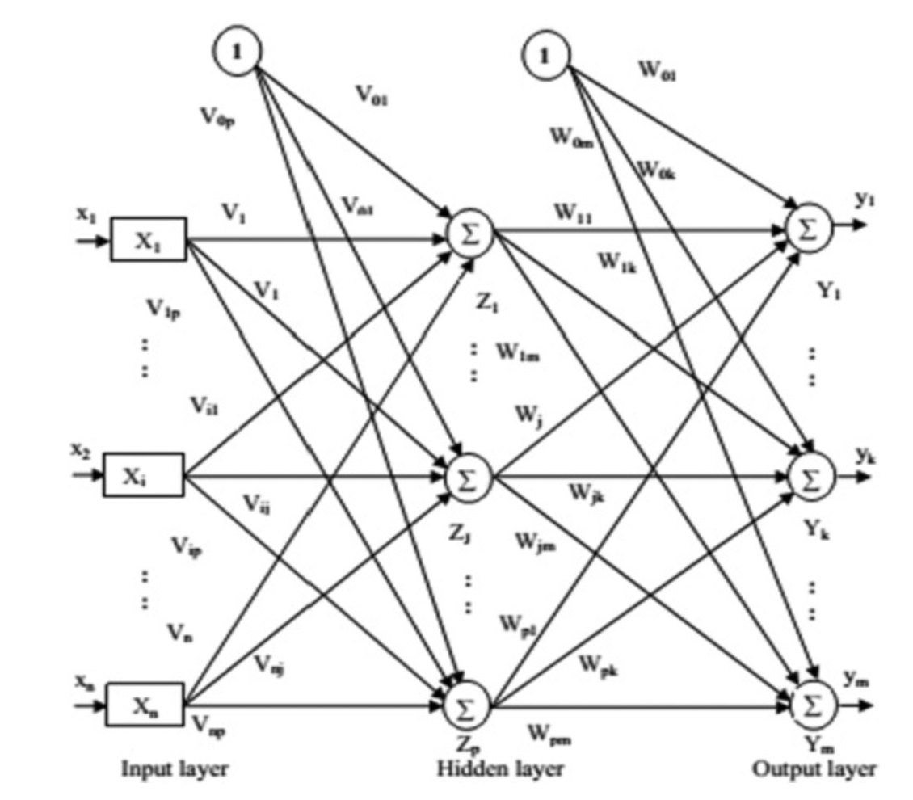
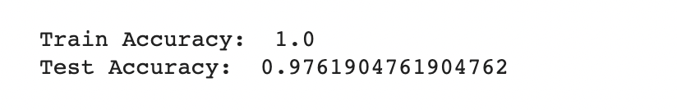
Neural Network
Multilayer Perceptrons:
Basic NN with fully connected layers
Supplement of feed-forward Neural network
Known for limited dataset accuracy
Used to solve complex nonlinear problems

Slide 16
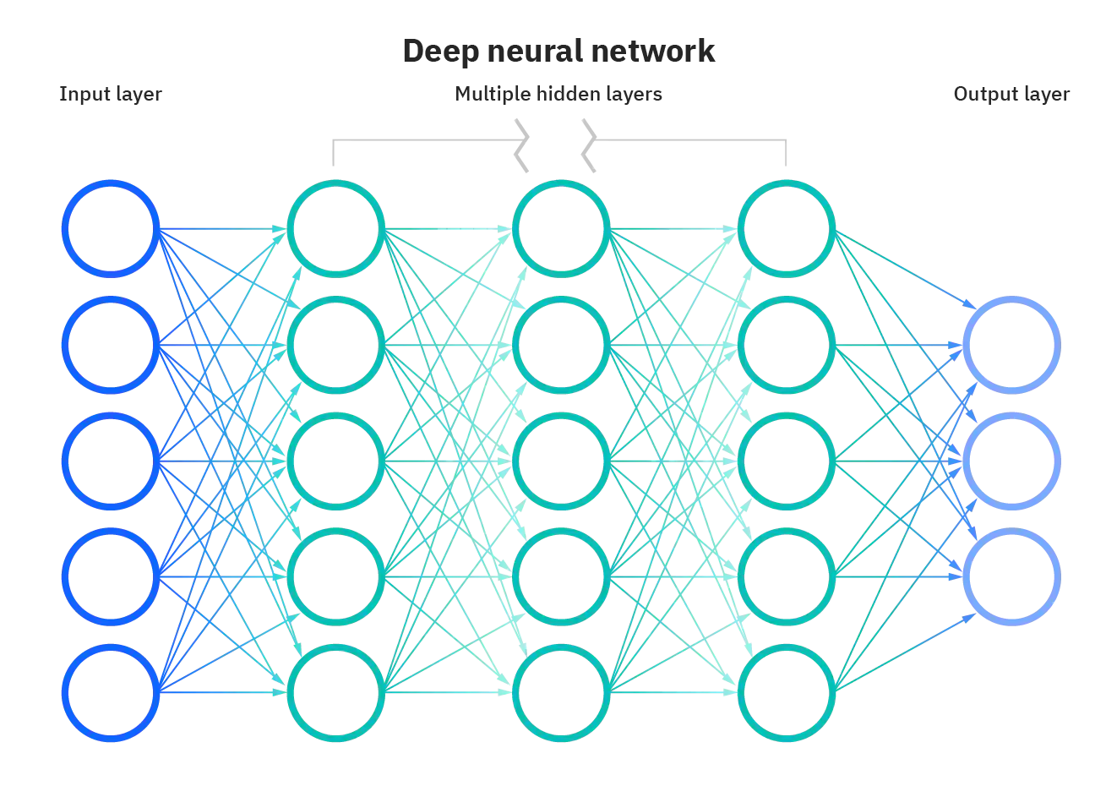
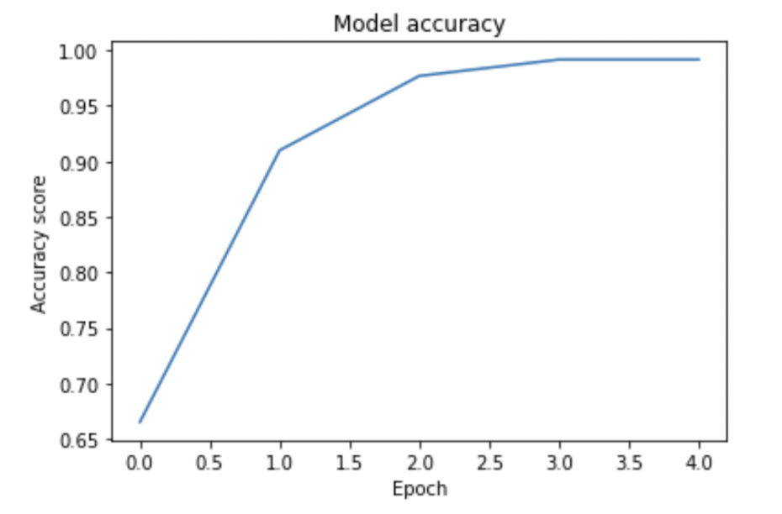
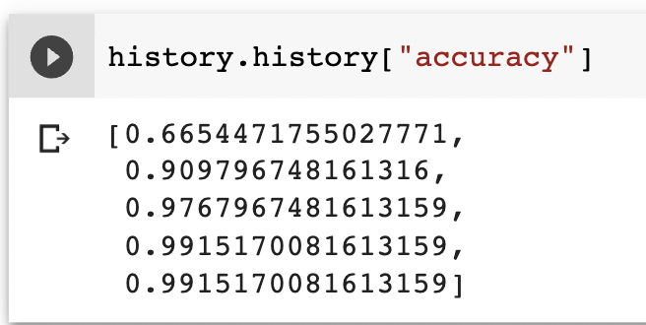
Neural Network
2. Deep Learning:
Contains multiple hidden layers
No need of feature extraction
We have used 3 hidden layers
Activation function used is ReLU

Slide 17
Comparative Analysis (1/2)
KNN was chosen as it has an advantage that it does not require any correlation between target variables and features. After running the model and analysis the accuracy has increased by almost 5%.
We choose a decision tree as missing values in the data do not affect the process of building a decision tree to any considerable extent. We got an accuracy of 95.7%.
Although decision tree model gave better accuracy compared to KNN and linear regression, we decided to develop a Neural Network model as well, as a small change in the data can cause a large change in the decision tree structure, causing instability.
Deep Learning model was chosen as it works best when the relation between the input and output is non-linear, which is the case for our dataset

Slide 18
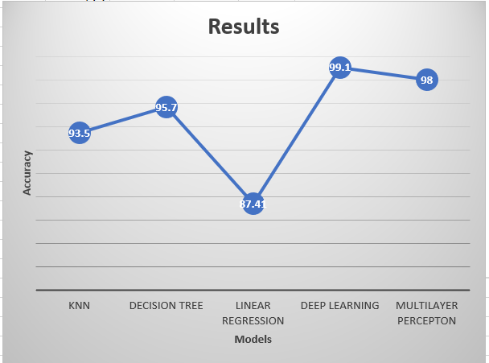
Comparative Analysis (2/2)
Among all the models implemented,
Deep Learning model predicted the
diseases with highest accuracy of
99.1%

Slide 19
Conclusion
The project presented a technique to predict the disease based on symptoms of an patient successfully
This model will help in reducing the cost and improving the recovery process of any patient
The Neural network model gave highest accuracy of 99.1% using the factors mentioned
For the other models the accuracy was low due to the dependency on the parameters as well as comparatively less data points
In Deep Learning model, successfully overcame overfitting by trying different sets of hidden layer dimensions

Slide 20
Future work
The models used a dataset which is comparatively smaller. The accuracies of these models, especially Neural Network, can be improved with larger dataset.
Any Artificial Intelligence technique can be used such as Prophetic analytics to predict the diseases more efficiently.
Some more models can be implemented with the larger dataset such as Random Forest, RNN, LSTM, etc.

Slide 21
THANK YOU!

